Slide 1


Secure Cloud Storage on Amazon Web Services
Group 12 members:
Quyen Tran, Chuong Dong, Cameron Newman
CS4675 - Spring 2021

Slide 2


Motivation
Reduce expense
Scalability
Enhance collaboration
Notes:
A lot of bussiness has move away from traditional local storage into storing data on cloud base service
Reduce expense: leaving the maintaining and developing the the infrasstructure to a third party service
Scalability with increasing customers and employees

Slide 3




Sensitive data
Notes:
Sensitive data are stored on cloud that can be accessed everywhere are big target for hackers

Slide 4
Goal
Sensitive data
Decryption
Encryption
Notes:
Encryption Decryption scheme when user want to upload and download files from AWS, an example of a cloud service provider.

Slide 5

Related work
Researchers have experimenting with hybrid-cryptography on their cloud storage through using the combination of RSA-AES
They have also done research about uploading/downloading speed on different cloud storages
Notes:
Quyen

Slide 6
Approach
Front-end development (Vaadin): Quyen
AWS and Cryptography: Chuong
Back-end development(Vaadin + Spring Boot): Cameron

Slide 7
Front end design

Slide 8

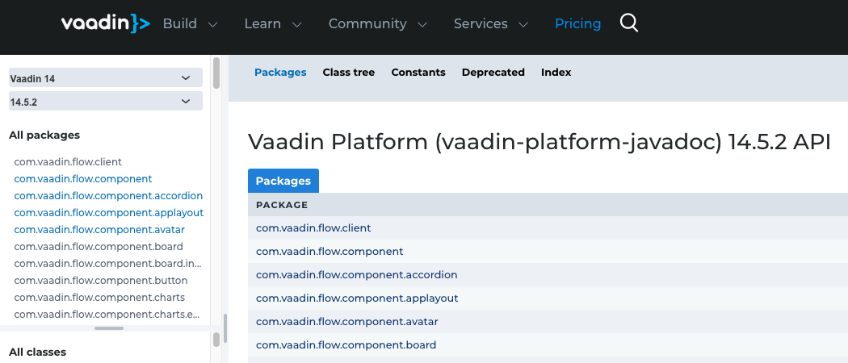
Web Application
Installation requirements
Java SDK 15
Maven
Node. Js
AWS Java SDK
Amazon Correctto 11
Itelli J IDEA
Notes:
None of us has buitl a web application before so we followed a tutorial on Youtube . They used Vaadin as the platform to do so. It allows to create interactive user interface using Java language with big API library.

Slide 9
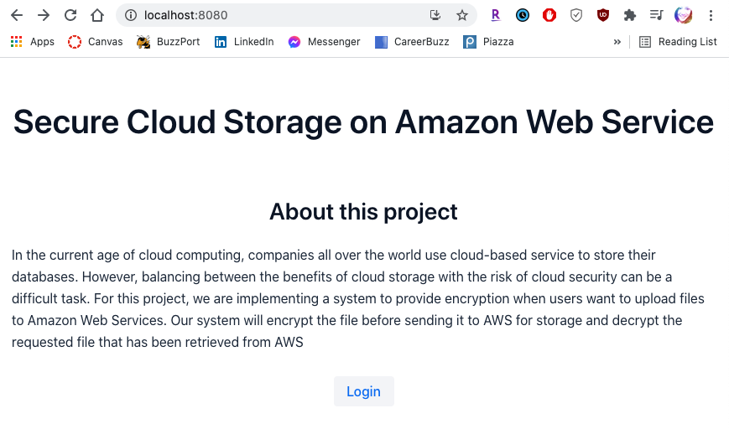
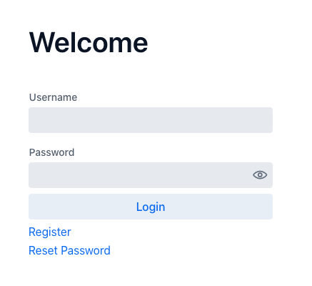
Front End
Default page

Slide 10
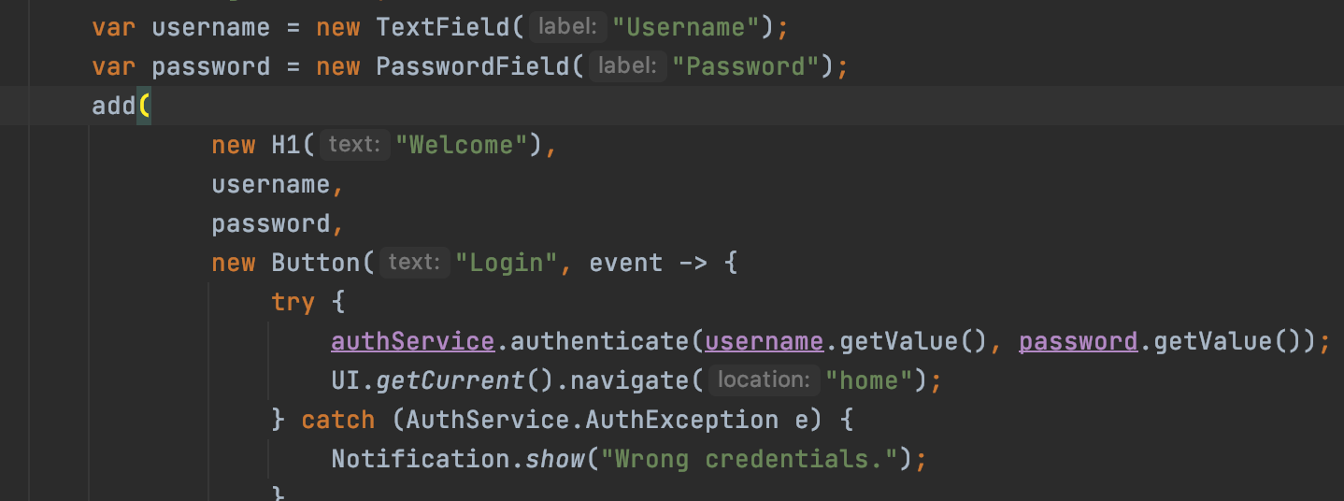
Login page

Slide 11
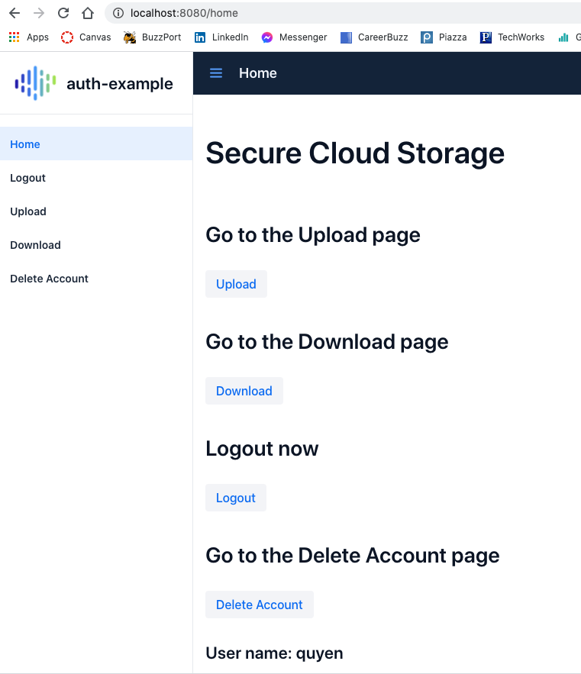
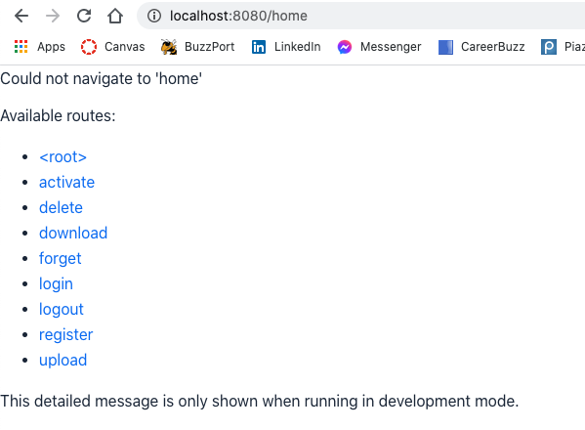

Home view
Notes:
Done authentication, can access home page to perform uploading, download functions and account management.
The app is oconfigured so that you cannot passby the authentication by entering the page link,

Slide 12
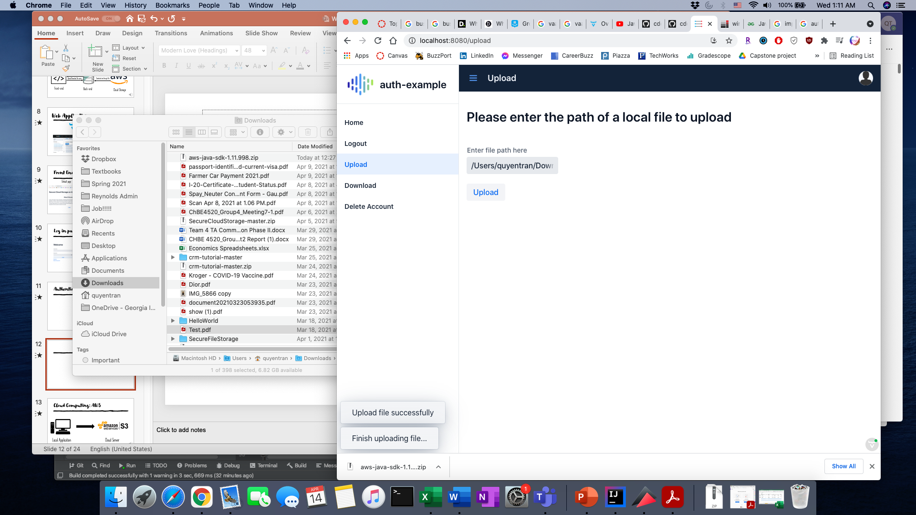
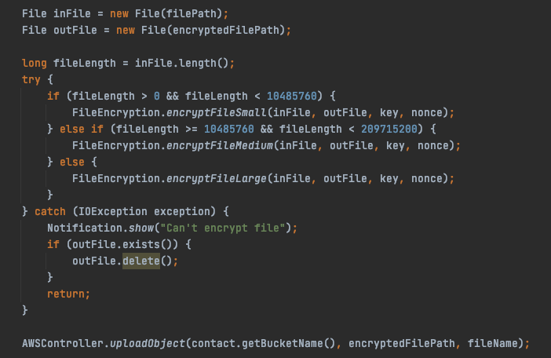
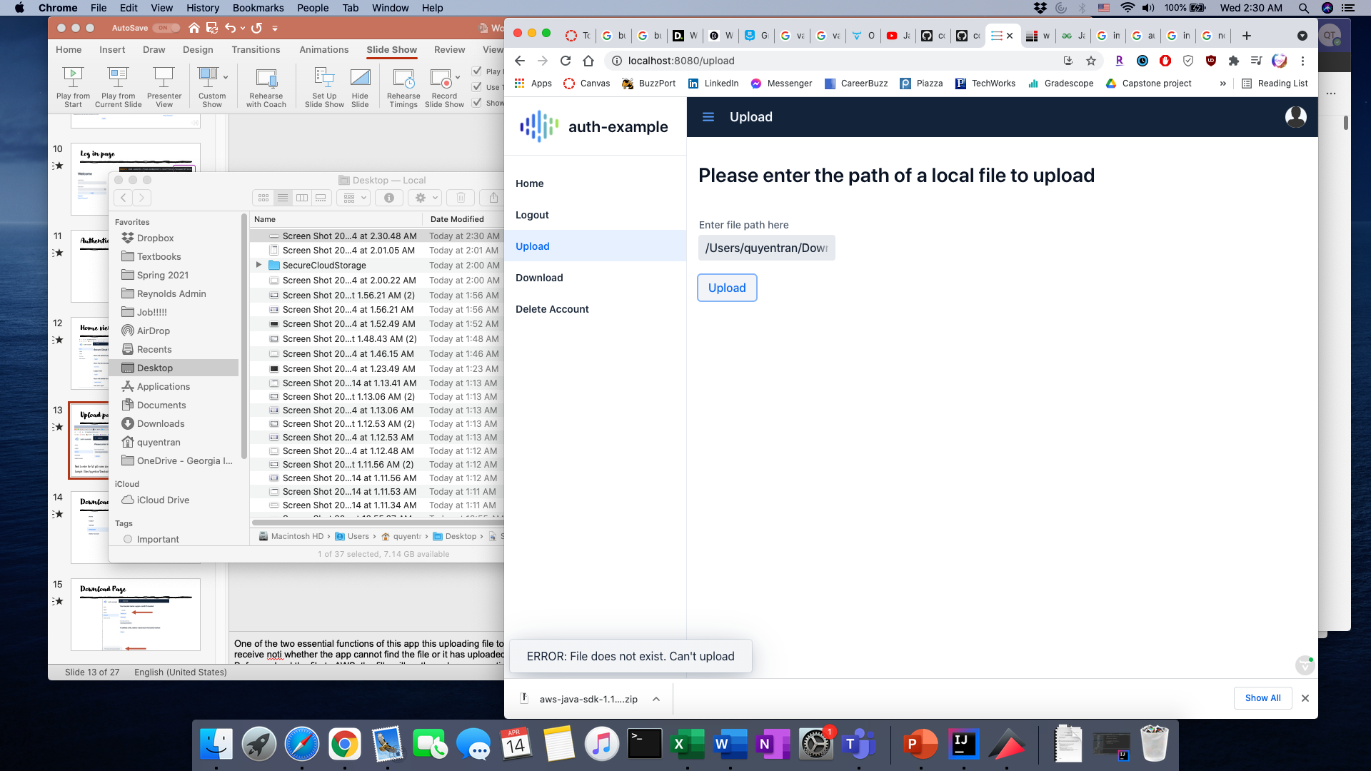
Upload page
Need to enter the full path link along the file extension
Example: /Users/quyentran/Downloads/Test.pdf
Notes:
One of the two essential functions of this app this uploading file to AWS.
receive an success upload noti or an error one that the app cannot fine your file.
In the back end Before upload the file to AWS, the fille will go through an encryption process. This encryption scheme will be dicusses further in later slice

Slide 13
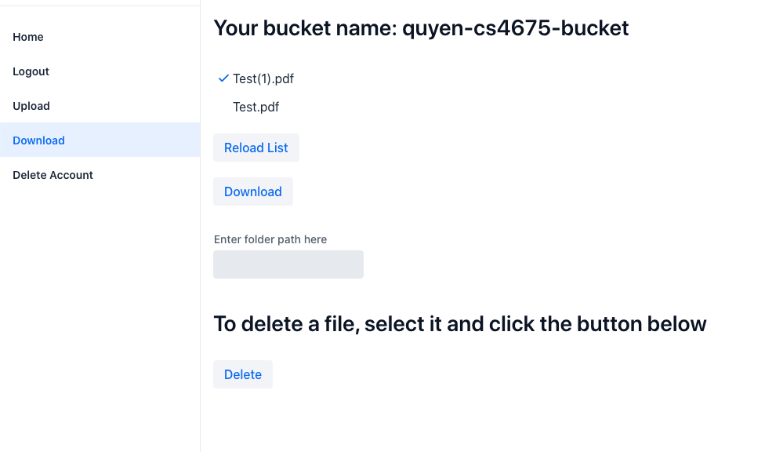
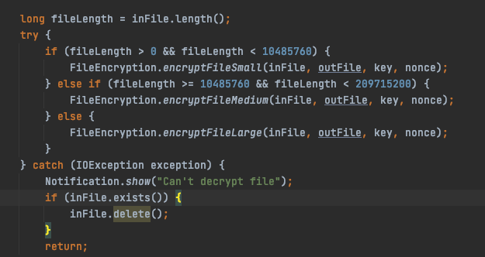
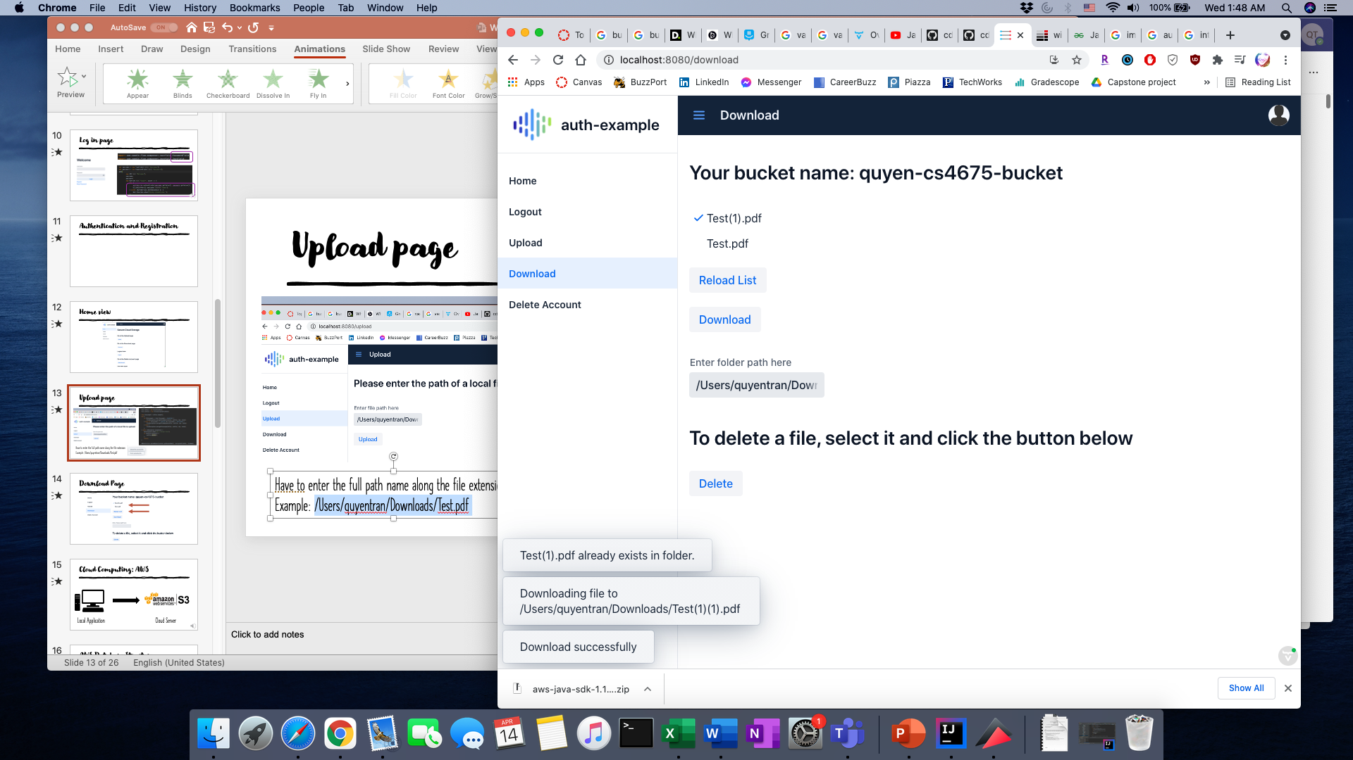
Download Page
Notes:
generate list of all the files in your bucket. Refresh by clicking the reload button
To download, click to select the file and provide a path to the destination folder in your computer
if there is a name conflict between the downloading file and exisiting files in your folder, the app will automatically add (1) extention to the name
Just as uploading, the file will be through an dedryption process between arriving in your folder

Slide 14
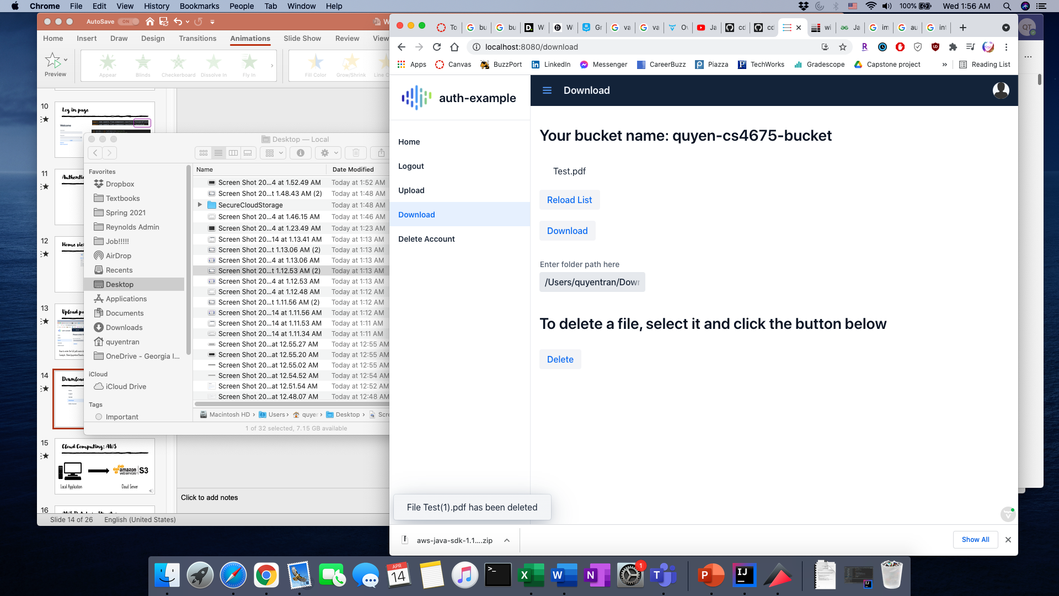
Download Page - Deleting

Slide 15
Connecting to AWS

Slide 16


Cloud Computing: AWS
Local Application
Cloud Server
Notes:
Since we want the app to take advantage of cloud computing for storage, we decided to go with AWS S3 (Simple Storage Service) -> explain AWS S3 for a bit. Pricing -> relatively cheap for storage. We can pay more as we need

Slide 17
AWS Database Structure
File A.1
Bucket A
File A.2
Database
File B.1
Bucket B
File B.2
File C.1
Bucket C
File C.2
Notes:
In the simplest form, our database on S3 will contains “buckets”. Each registered user will have one bucket ties to their name. When they upload files, they will go into this bucket.

Slide 18
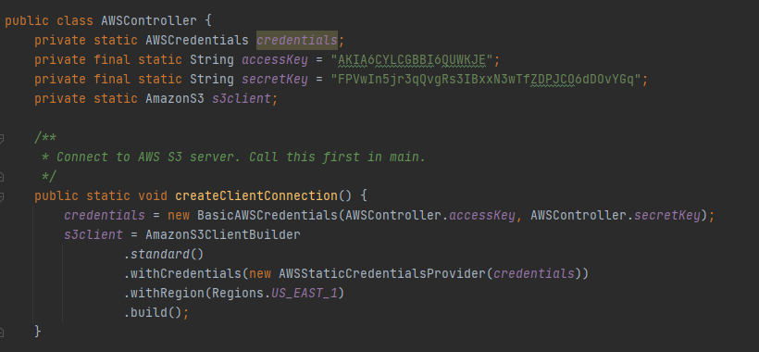
Code for AWS

Slide 19
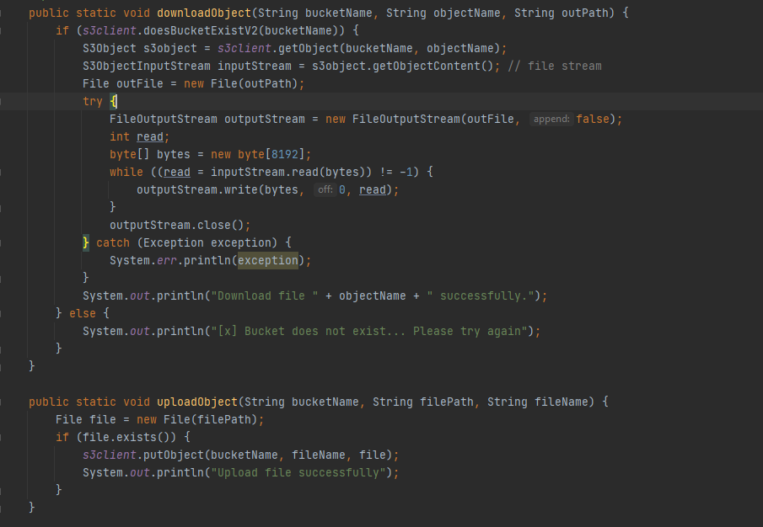
Code for AWS

Slide 20
AWS S3 Advantages
It is free (at least on a small scale!)
User-friendly
AWS S3 makes uploading, downloading, and storing operations convenient
They have an extensive Java SDK for us to interact with the AWS server
Notes:
AWS S3 makes uploading, downloading, and bucket operations convenient, and they have a dedicated Java SDK library for us to do all of these using Java

Slide 21
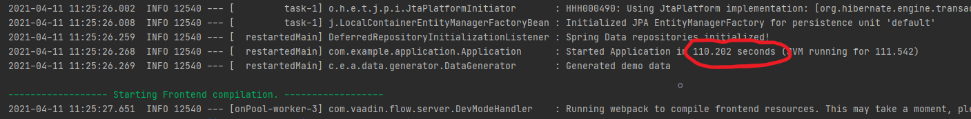
AWS Disadvantages
AWS SDK Library is too heavy, which significantly increases the time for our Application to boot up.
Notes:
AWS SDK Library is incredibly heavy, so when we import it in our Spring Web app, it takes around 1.5 to 2 minutes for the system to boot up, which is bad considering how it makes it harder for us to test our code.

Slide 22
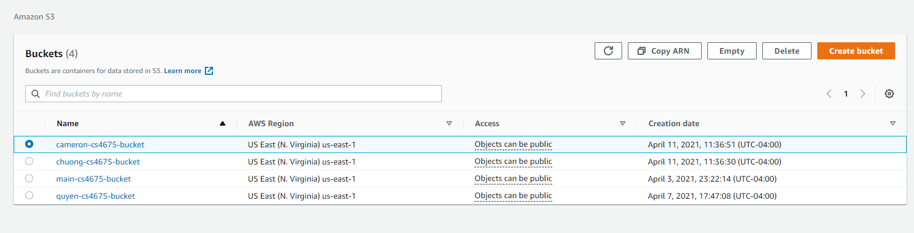
AWS Disadvantages
Bucket name collision due to global bucket pool
Notes:
Since AWS S3 has a global bucket pool, the bucket names we create must be universally unique on the platform. I found out about this when using “username_bucket” and running to errors saying that someone has already had that bucket name. Fixed this by doing “username_cs4675_bucket”

Slide 23
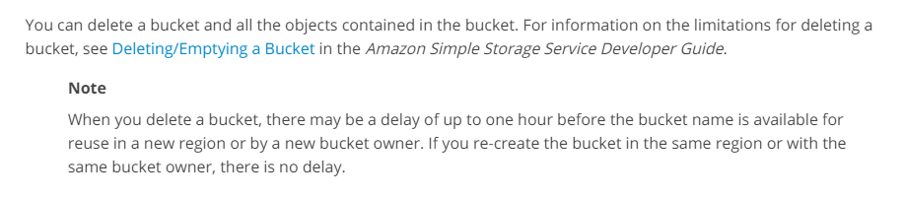
AWS Disadvantages
Bucket deletion delays due to synchronization
Notes:
AWS doesn’t delete buckets right away, so we could create a flag in our entry for the database that won’t delete the account from our database until the bucket in AWS is deleted = grace period. In addition, some time might pass before you can reuse the name of a deleted bucket. If you want to use the same bucket name, we recommend that you don't delete the bucket

Slide 24
Encryption Decryption scheme

Slide 25


Crypto: Password Encryption
We use our RSA public key to encrypt users’ passwords and store them in our database
RSA encrypted password
Register password
USER
APPLICATION
DATABASE
Notes:
Our web app’s database stores the users’ encrypted passwords. When a user creates an account, we will import our RSA public key to encrypt the password before storing that in our database.
Our RSA Private key will be kept a secret. This is so that only us can use the private key to decrypt this encrypted password thanks to Public key cryptography

Slide 26
Crypto: Authentication
We internally use our RSA private key to decrypt the user’s password in the database and compare it to the password provided during authentication
Provide username and password
Decrypt password and compare
Log user in if passwords match
USER
APPLICATION
Notes:
For authentication, we will import our RSA private key to decrypt the password we stored and compare it with the password being given. Because the private key only exists in memory for a short period of time, it is impossible for it to be extracted, and it can ensure that only we can decrypt the user’s password.

Slide 27
Crypto: ChaCha20 Encryption
For file encryption, we decide to use ChaCha20 instead of AES for better performance (and better name, of course)
It’s an ARX (ADD-ROTATE-XOR) stream cipher developed by Daniel J. Bernstein
Widely used by ransomware gangs for its strong encryption and speed!
Notes:
On a general-purpose 32-bit (or greater) CPU without dedicated instructions, ChaCha20 is generally faster than AES. The reason for this is the fact that ChaCha20 is based on ARX (Addition-Rotation-XOR), which are CPU friendly instructions. At the same time, AES uses binary fields for the S-box and Mixcolumns computations, which are generally implemented as a look-up table to be more efficient. Explain ChaCha20 and hybrid cryptography -> compare with AES

Slide 28
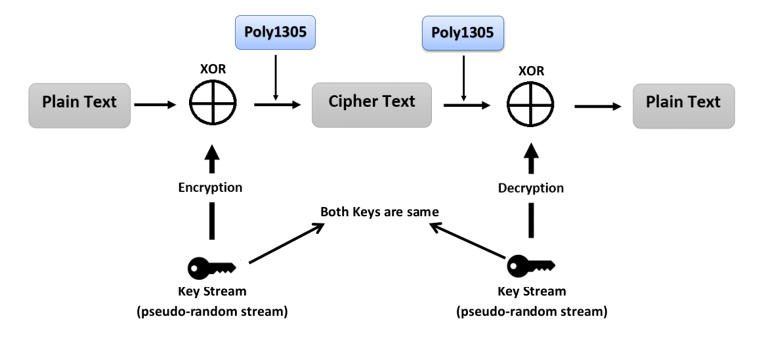

Crypto: ChaCha20 Encryption
Notes:
Key stream is generated from a 32-bytes key and 8-bytes nonce that go through 20 rounds of ChaCha20 block function. The plaintext data is xor-ed with this key stream to create the encrypted text. The decryption happens the same way but in reverse. Because of XOR, if you encrypt the cipher text using the same key-nonce, you’lll get the plaintext again

Slide 29
Crypto: ChaCha20 Key-nonce
ChaCha20 Key
First 32 bytes
SHA512
User’s raw password
Hashed password
Next 8 bytes
ChaCha20 Nonce
Notes:
Now that a user’s password is protected, we will use the raw password to generate a hash of 512 bytes from SHA-512. The first 32 bytes of this hash will be used as our ChaCha20 key, and the next 8 bytes of this hash will be used as our ChaCha20 nonce. Hybrid cryptography to protect the key-nonce since user’s raw password is protected by RSA.

Slide 30
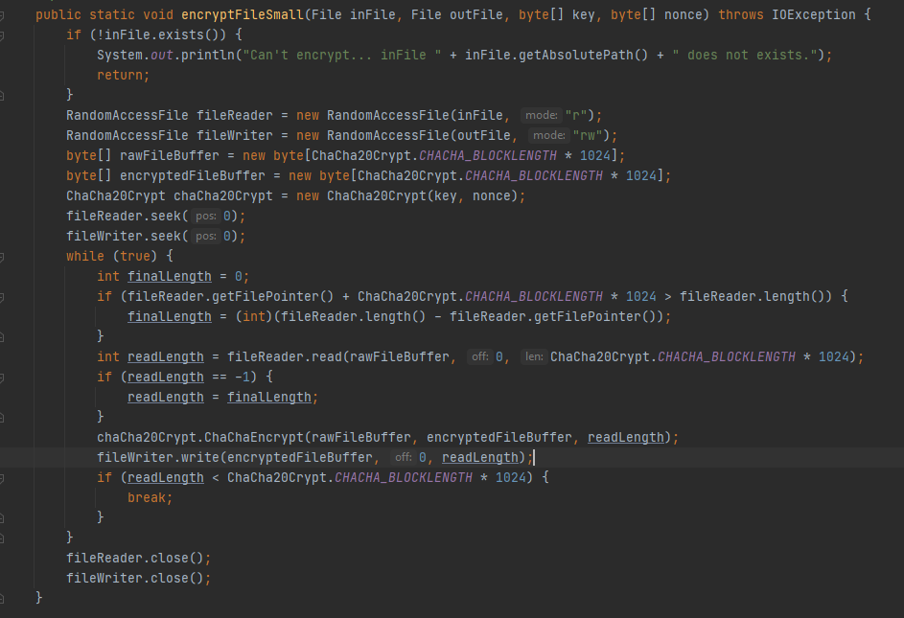
Small File Encryption

Slide 31
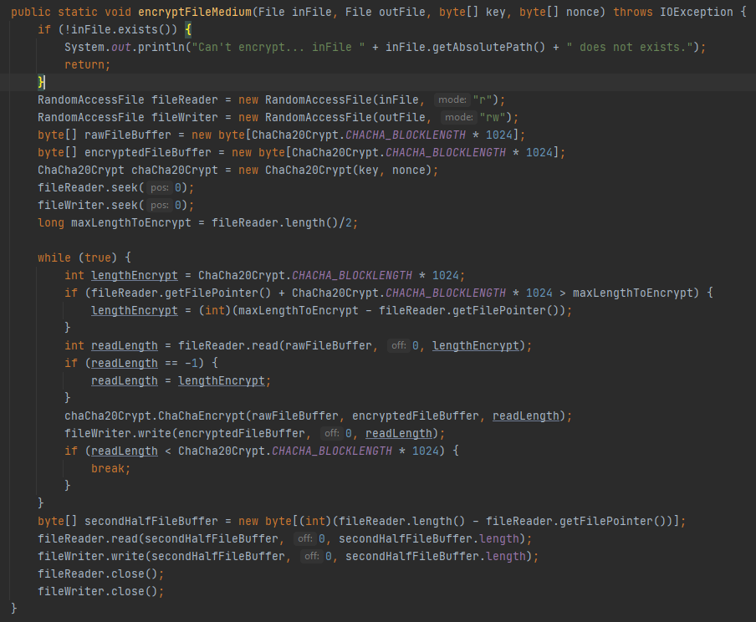
Medium File Encryption

Slide 32
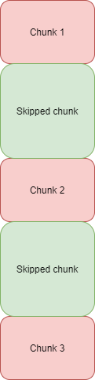
Large File Encryption
Size(Chunk 1) = size(Chunk 2) = size(Chunk 3) = ~ 5.3% File size
If Chunk size is too large, restrict each to 113.86 MB to
ensure encryption/decryption takes at most 1.5 seconds
Requires precise chunking to stay
consistent and avoid alignment problems

Slide 33
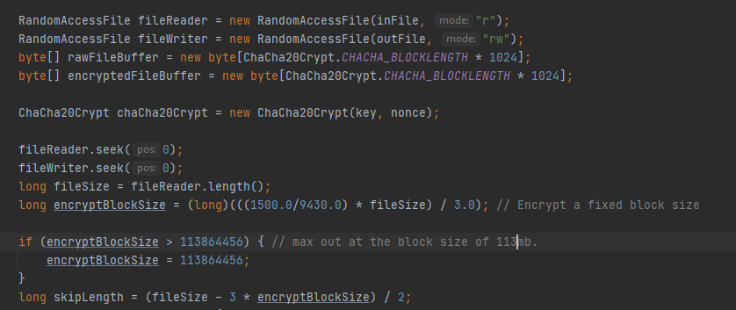
Large File Encryption

Slide 34
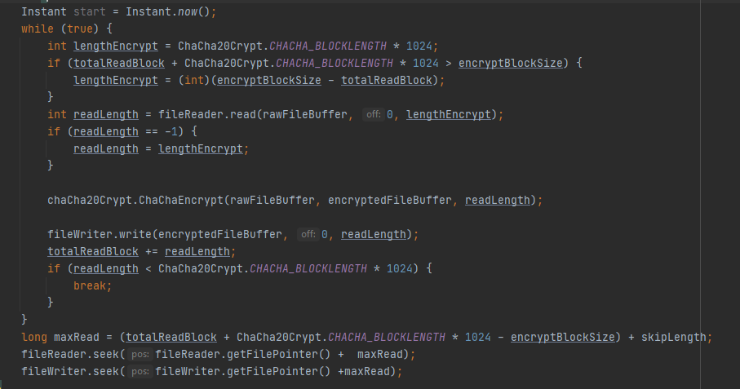
Large File Encryption

Slide 35

Crypto: Encryption Speed
Notes:
With my implementation, I make the encryption/decryption extremely fast. With any file from 0 – 200mb, the encryption takes less than a second.
For any file above that, I made it so the encryption speed max out at 1.5 seconds.
Overhead only comes from network speed

Slide 36
Backend development

Slide 37


Overall Design
Front End
Database
Encryption/Decryption
AWS
Create Account
Forgot Password
Verify Username
Encrypt Password
Update/Store Password
Delete Account
Verify Username
Delete Bucket
File Upload
Delete User
File Download
File Access
Get User's Bucketname
Encrypt File
Put in User's Bucket
Get User's Bucketname
Get File
Decrypt File
Delete File
Get User's Bucketname
Remove File

Slide 38
Implementation
Database: HashMap<User, Contact>
User Object Attributes: username, activation code, and active flag
Contact Object Attributes: AWS bucket name, encrypted password, Security Questions object
This object is how we access AWS
Security Question object: individual answers to security questions, currently address, favorite color, and favorite animal
**Best Organization for us!**

Slide 39
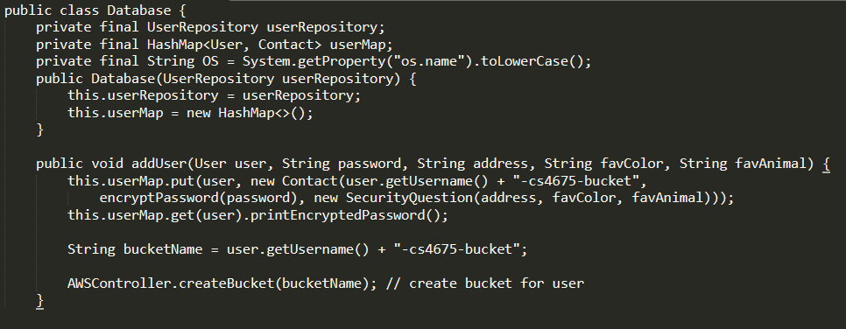
Database

Slide 40
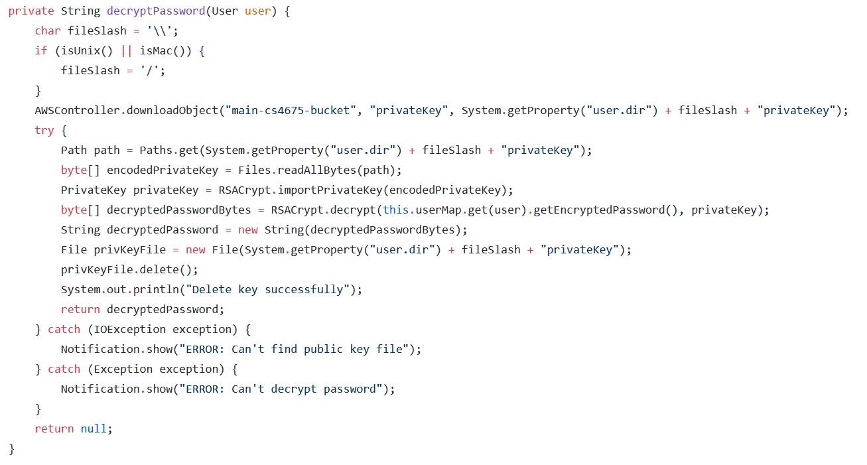
Decrypt Password

Slide 41
AWS Versions Pros and Cons
Free Version
Paid Version
It's free!!!
Only 100 buckets per server = 100 users per server
It's not free
Unlimited buckets aka users per server
Winner: AWS Free Version!!!
Why:
We're broke
More Secure because we can compartmentalize more!

Slide 42
Testing

Slide 43
Login time
Login time stays relatively stable .
Since we use a hash table to store user’s encrypted password, querying it takes almost constant time.
Fluctuation comes from Internet speed of downloading the RSA Private key to decrypt the stored password

Slide 44
Verifying and changing password time
Changing password requires querying the user’s security questions stored in the local database, which takes constant time (hash table).
The outlier at 10 users was out of our prediction. We suspect there is overhead from the operation to set up and query the database for the first time when we tested it.
Notes:
Cameron

Slide 45
File encryption time
Notes:
Chuong

Slide 46
Potential Improvement
Secure our private key
Eliminate having a single point of failure (2 databases)
Extend our service on AWS S3 to support more than 100 buckets

Slide 47
Potential Improvement
Have our own server to host our Web app and perform encryption/decryption there instead of on users’ local machine
Implement better UI/UX for our Web app

